Slide 1

Configuration Interface
strictly confidential
Overview

Slide 2
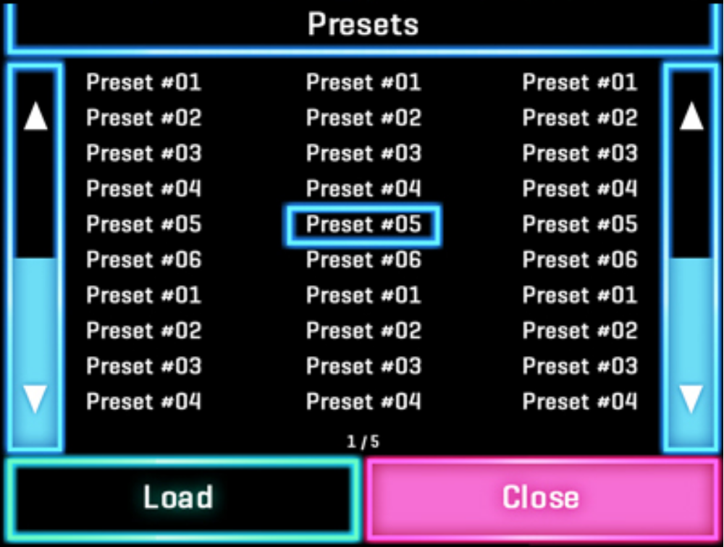
Presets Screen
strictly confidential
SAVE

Slide 3
Synth Screen
strictly confidential
SYNTH / MIDI
SYNTH
SYNTH
FX1
MIDI
<
E
4
>
MIDI
<
B
4
>
SYNTH
MIDI
<
G
3
>
SYNTH
MIDI
SYNTH
FX1
MIDI
<
D
3
>
MIDI Channel: 3
MIDI
<
A
3
>
SYNTH
MIDI
<
E
2
>
SYNTH
MIDI
MIDI CONTROLS
CLOSE

Slide 4
Controls Screen
strictly confidential
CONTROL ASSIGNMENTS
PARAM
CC 16
pitch
velocity
velocity
velocity
velocity
CHAN
0
0
0
1
2
3
CONTROL
touch_x
drag_x
touch_y
touch_y
touch_y
touch_y
INV
no
no
yes
no
yes
yes
ADD NEW
DELETE
DELETE ALL
CLOSE
this will delete all synth controls as well
(get confirmation first)

Slide 5
Controls Screen
strictly confidential
MIDI CONTROL
CONTROL:
touch_x
PITCH
VELOCITY
CC
CHANNEL:
14
INV
OK
CLOSE

Slide 6
Controls Screen
strictly confidential
MIDI CONTROL
CONTROL:
touch_x
PITCH
VELOCITY
CC
CHANNEL:
14
INV
OK
CLOSE

Slide 7
Controls Screen
strictly confidential
MIDI CONTROL
CONTROL:
touch_x
PITCH
VELOCITY
CC
CHANNEL:
14
CONTROL NUM:
100
INV
OK
CLOSE

Slide 8
Voice Screen (1)
strictly confidential
Waveforms:
0. saw
sin
square
triangle
xenoxpad
riverpad
loungepad
chinapad
spiritchoir
strings
systrings
dronepad
tjampad
southpad
jazzistik
sekentar
leadman
beatporte
moglead
windlead
patlead
sybrass1
sybrass2
sitara
VOICE
WAVEFORM:
saw
AMP
ATTACK
AMP
DECAY
AMP
RELEASE
FILT
FREQ
FILT
RES
FX1
FX1
FX2
FX2
ON
CLOSE

Slide 9
Voice Screen (2)
strictly confidential
VOICE
DETUNE
COURSE
DETUNE
FINE
VIBRATE
RATE
VIBRATE
DEPTH
VIBRATE
DELAY
FX1
FX1
FX2
FX2
ON
CLOSE

Slide 10
Voice Screen (3)
strictly confidential
VOICE
PORTM
TIME
PAN
PITCH.W
SEMI
TONES
PITCH
WHEEL
VELOCITY
FX1
FX1
FX2
FX2
ON
CLOSE

Slide 11
Voice Screen (4)
strictly confidential
VOICE
REVERB
SEND
LEVEL
FX1
FX1
FX2
FX2
ON
CLOSE

Slide 12
Waveform Screen
strictly confidential
Waveforms
saw
sin
square
etc…

